Slide 1
BBM416 – Fundamentals of Computer Vision Spring 2022

Slide 2
What we will learn today
Edge detection
Image Gradients
A simple edge detector
Sobel edge detector
Canny edge detector
Template Matching
Fitting: Hough Transform
Slides are mostly adapted from
Stanford CS131 course
Some background reading:
Forsyth and Ponce, Computer Vision, Chapter 8

Slide 3
Image filtering
Uses of filtering:
Enhance an image (denoise, resize, etc)
Extract information (texture, edges, etc)
Detect patterns (template matching)
Adapted from Derek Hoiem
Notes:
3

Slide 4
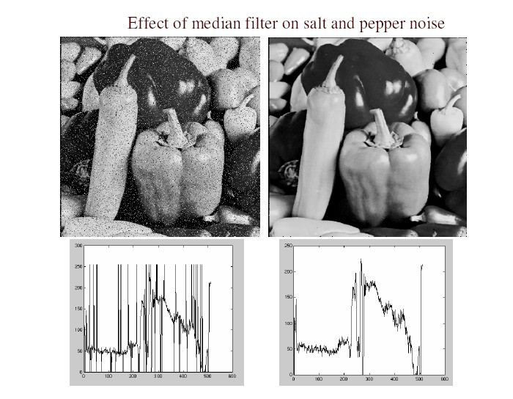
Filters for features
Previously, thinking of filtering as a way to remove or reduce noise
Now, consider how filters will allow us to abstract higher-level “features”.
Map raw pixels to an intermediate representation that will be used for subsequent processing
Goal: reduce amount of data, discard redundancy, preserve what’s useful

Slide 5
What we will learn today
Edge detection
Image Gradients
A simple edge detector
Sobel edge detector
Canny edge detector
Template Matching

Slide 6
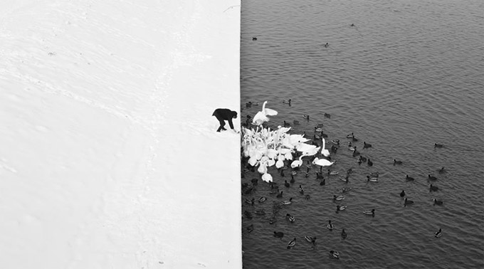
Edge detection
Winter in Kraków photographed by Marcin Ryczek
Slide Credit: S.Lazebnik

Slide 7
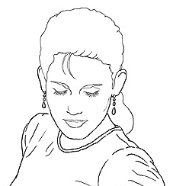
Edge detection
Goal: map image from 2d array of pixels to a set of curves or line segments or contours.
Why?
Main idea: look for strong gradients, post-process
Figure from J. Shotton et al., PAMI 2007
Intuitively, most semantic and shape information from the image can be encoded in the edges
More compact than pixels
Slide Credit: T. Darrell

Slide 8
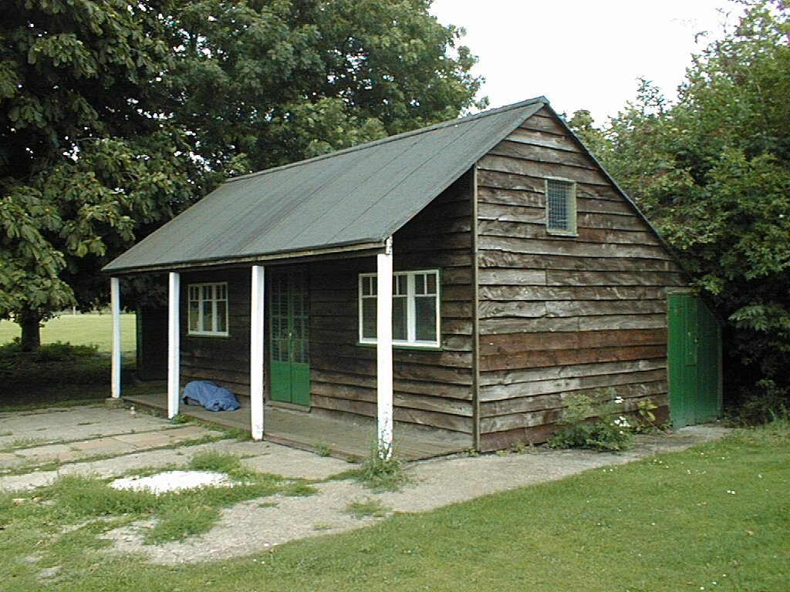
Why do we care about edges?
Extract information, recognize objects
Recover geometry and viewpoint
Vanishing
line
Vertical vanishing
point
(at infinity)
Vanishing
point
Vanishing
point
Source: J. Hayes

Slide 9
Origins of edges
surface normal discontinuity
depth discontinuity
surface color discontinuity
illumination discontinuity

Slide 10
Closeup of edges
Surface normal discontinuity

Slide 11
Closeup of edges
Depth discontinuity

Slide 12
Closeup of edges
Surface color discontinuity

Slide 13
What we will learn today
Edge detection
Image Gradients
A simple edge detector
Sobel edge detector
Canny edge detector
Template Matching

Slide 14
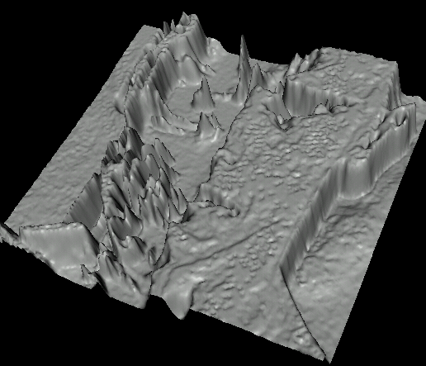
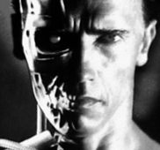
Recall : Images as functions
Edges look like steep cliffs
Source: S. Seitz

Slide 15

Derivatives and edges
An edge is a place of rapid change in the image intensity function.
intensity function (along horizontal scanline)
image
first derivative
edges correspond to extrema of derivative
Source: L. Lazebnik

Slide 16
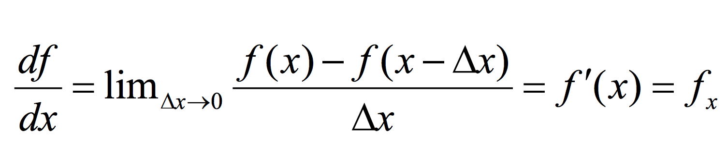
Derivatives in 1D

Slide 17
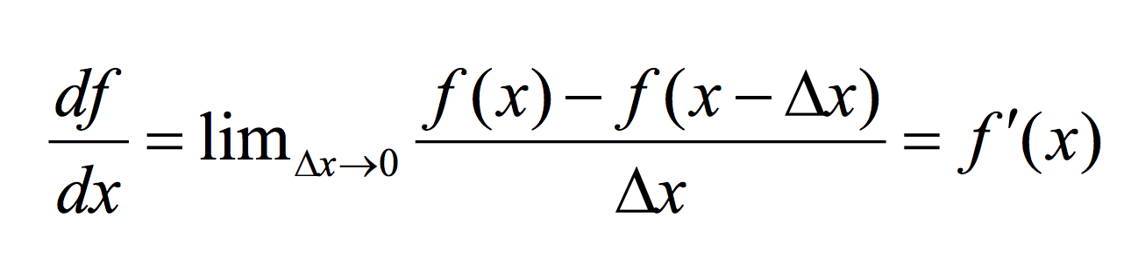
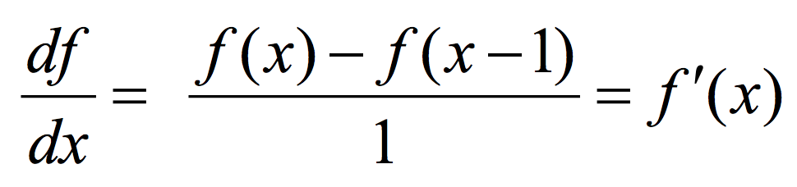
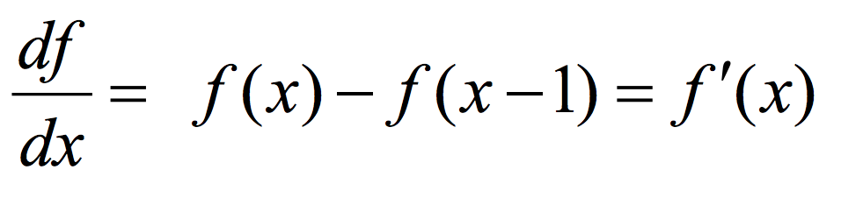
Discrete Derivative in 1D

Slide 18
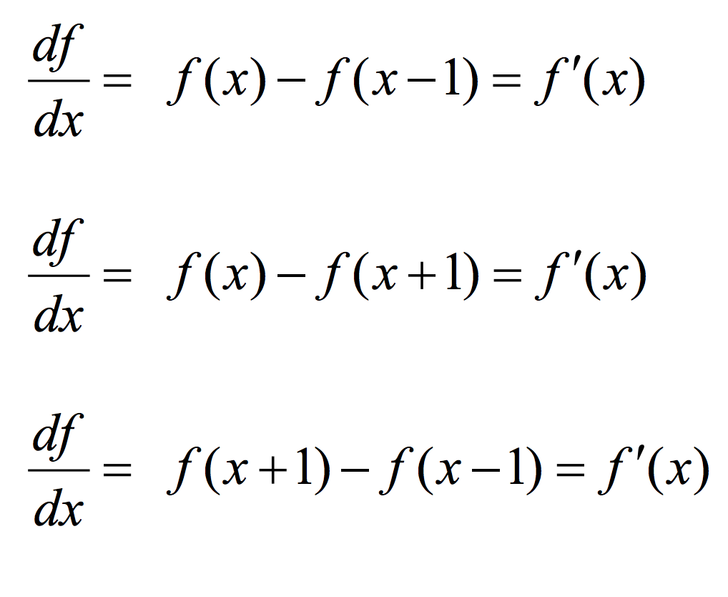
Types of Discrete derivative in 1D
Backward
Forward
Central

Slide 19
1D discrete derivate filters
Backward filter: [0 1 -1]
Forward: [-1 1 0]
Central: [ 1 0 -1]
Notes:
We can write these as filters!
If we do that then, we will be able to compute derivatives with convolutions.
First, case: output derivative is: center pixel, minus previous pixel (pixel to the left)
Q: Why does is filter kernel has a -1 to the right?

Slide 20
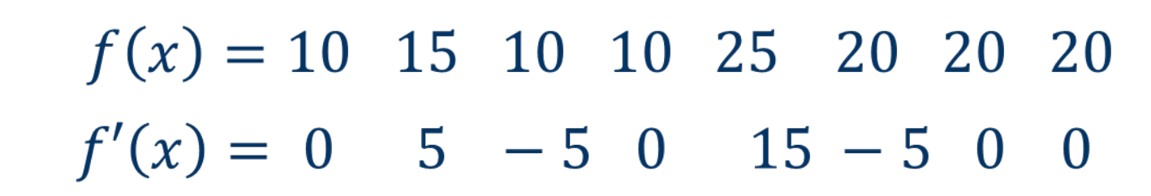
1D discrete derivate example

Slide 21
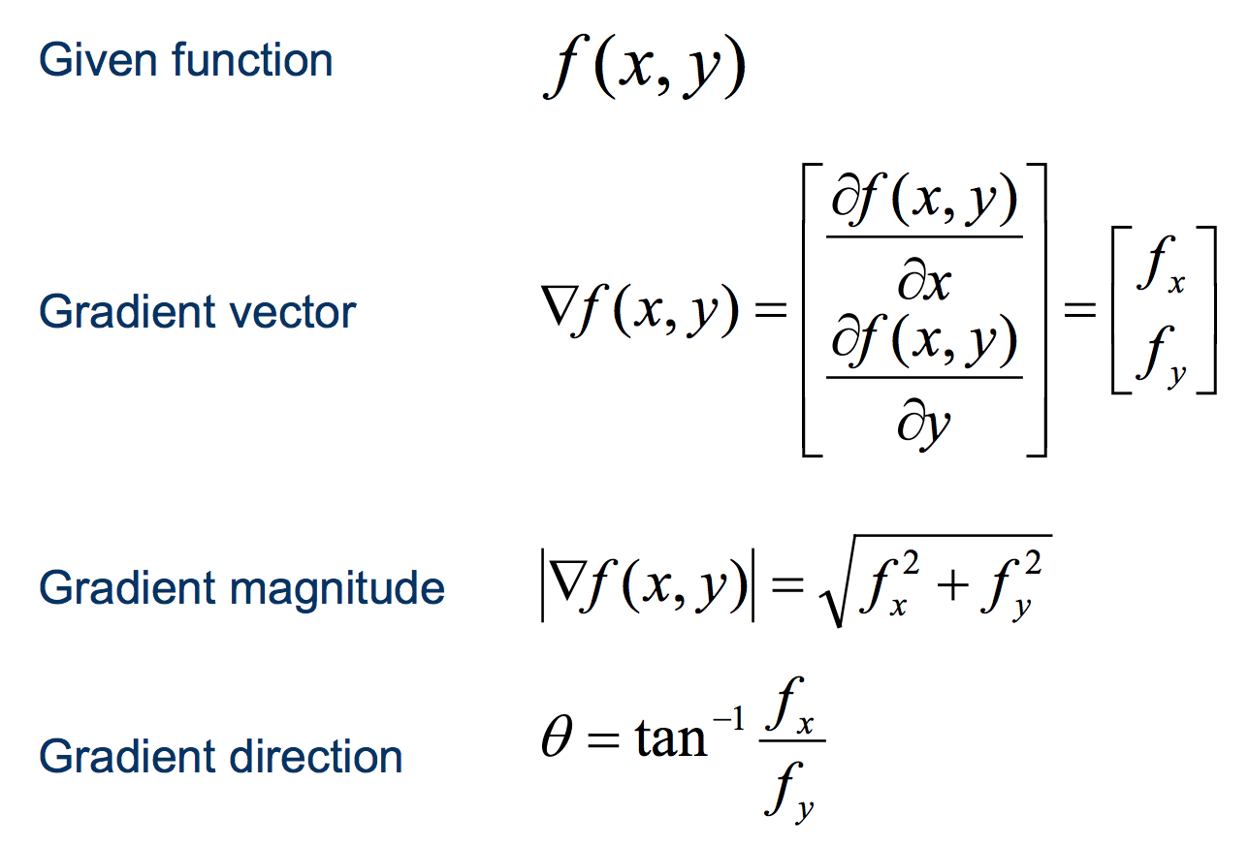
Discrete derivate in 2D

Slide 22
Discrete derivate in 2D
Notes:
For multi-varied functions (more than one variable)
Derivatives generalize into Gradients
Gradient VECTOR.

Slide 23
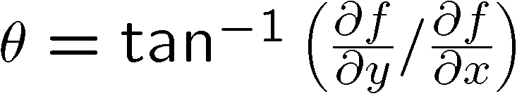
Discrete derivate in 2D
Notes:
It has:
Magnitude
Orientation

Slide 24
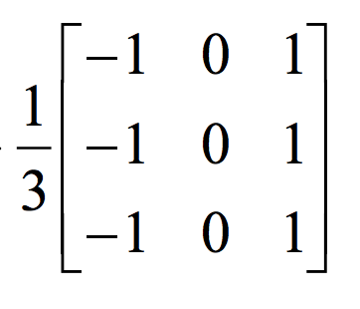
2D discrete derivative filters
What does this filter do?
Notes:
Derivative in x direction
+ something else?
Computes 3 derivatives and then average
1. Convention?
2. Correlation or Convolution?

Slide 25
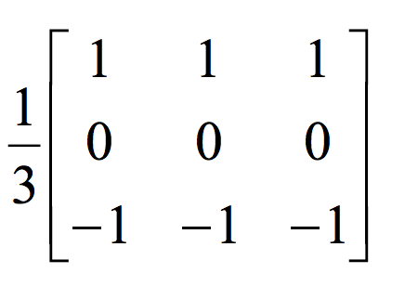
2D discrete derivative filters
What about this filter?
Notes:
Derivative in y direction

Slide 26
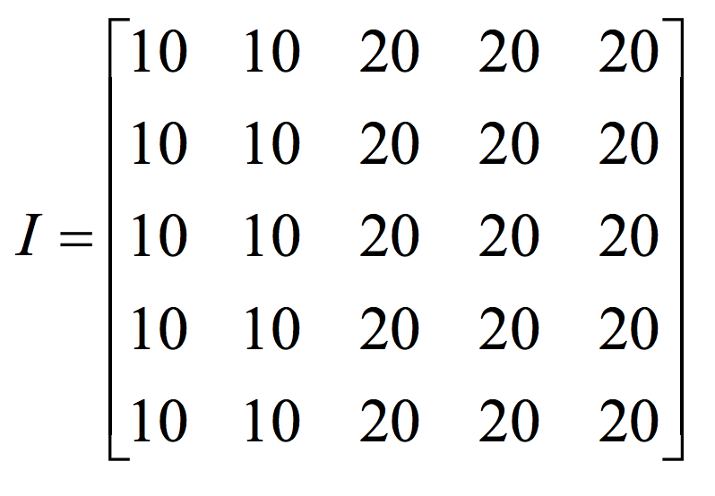
2D discrete derivative - example

Slide 27
2D discrete derivative - example
What happens when we apply this filter?

Slide 28
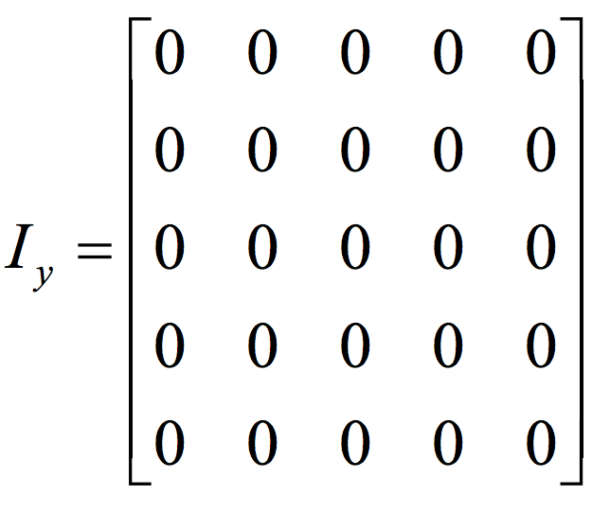
2D discrete derivative - example
What happens when we apply this filter?

Slide 29
2D discrete derivative - example
Now let’s try the other filter!

Slide 30
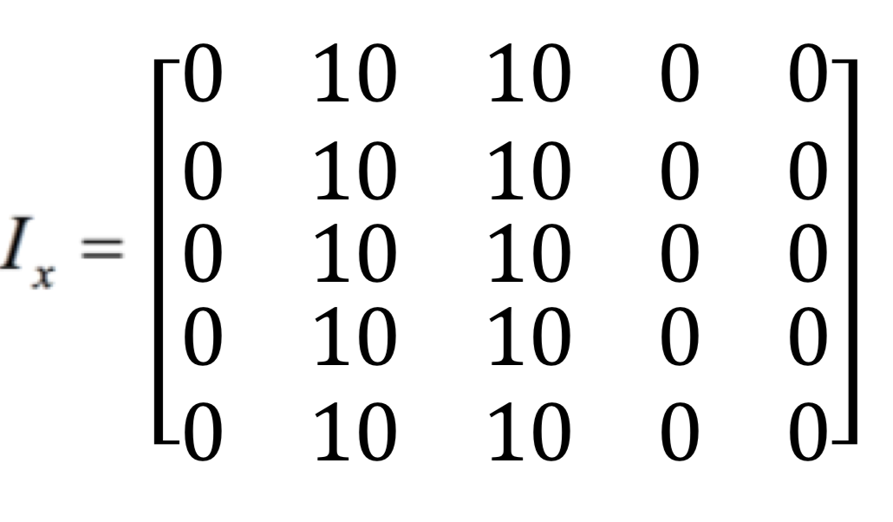
2D discrete derivative - example
What happens when we apply this filter?

Slide 31
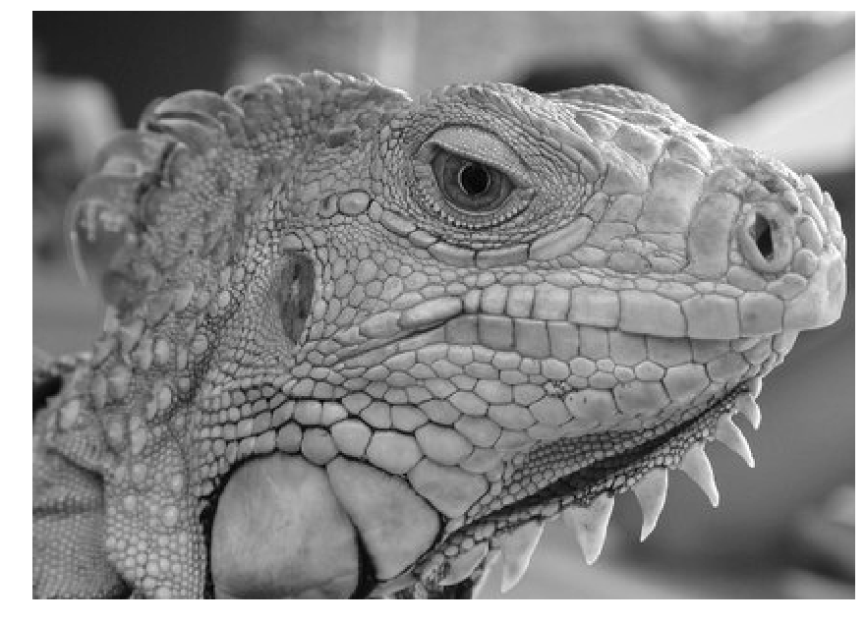
3x3 image gradient filters

Slide 32
What we will learn today
Edge detection
Image Gradients
A simple edge detector
Sobel edge detector
Canny edge detector
Template Matching

Slide 33
Derivatives and edges
An edge is a place of rapid change in the image intensity function.
intensity function (along horizontal scanline)
image
first derivative
edges correspond to extrema of derivative
Source: L. Lazebnik

Slide 34

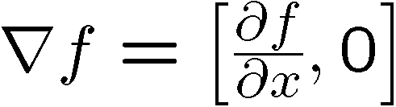

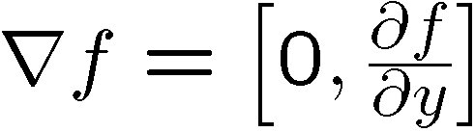
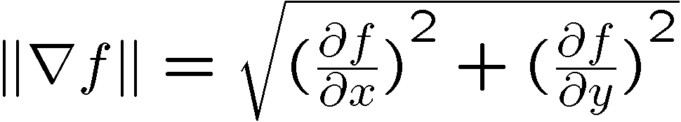
Image gradient
The gradient of an image:
The gradient vector points in the direction of most rapid increase in intensity
The gradient direction is given by
how does this relate to the direction of the edge?
The edge strength is given by the gradient magnitude
Source: Steve Seitz
Notes:
Gradient points towards direction of maximum change!
give definition of partial derivative: lim h->0 [f(x+h,y) – f(x,y)]/h

Slide 35
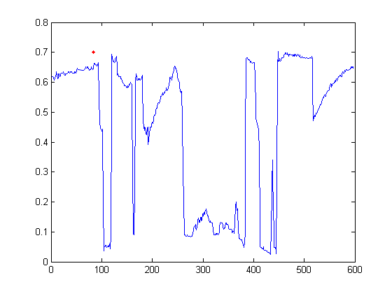
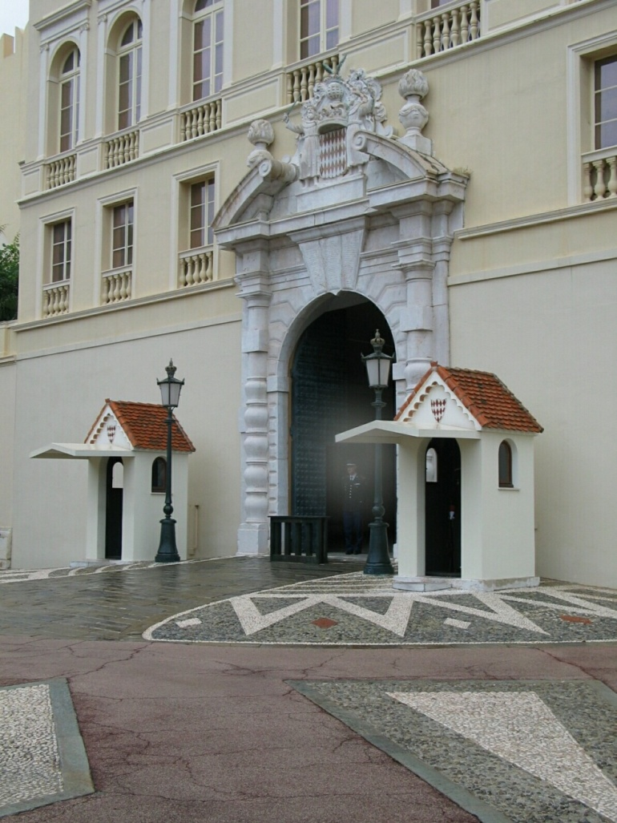
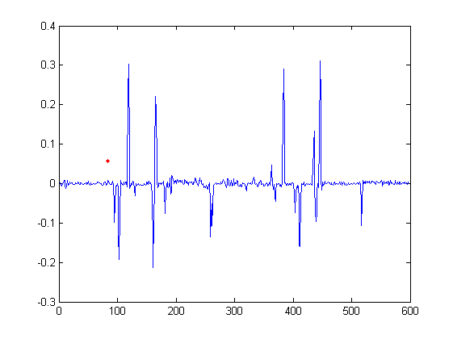
Intensity profile
Intensity
Gradient
Source: D. Hoiem

Slide 36
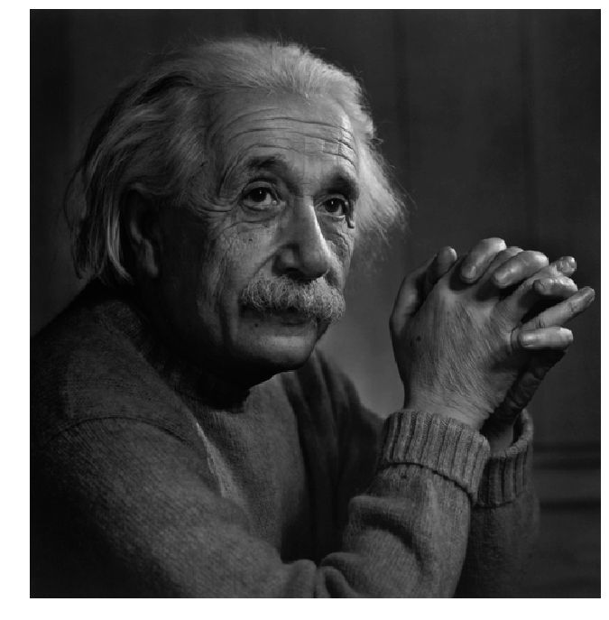
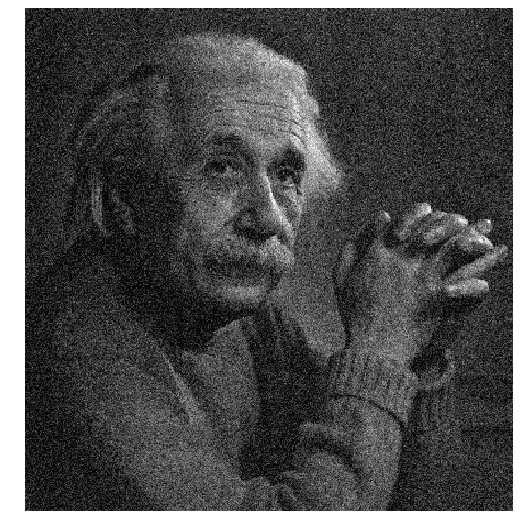
Effects of noise
Notes:
How to fix?

Slide 37
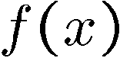
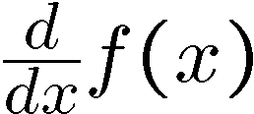
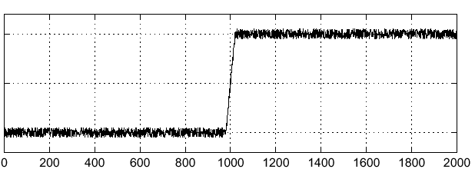
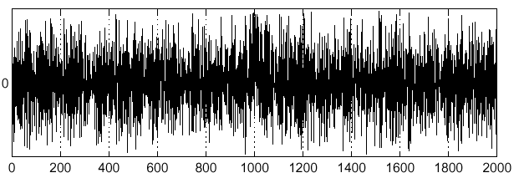
Effects of noise
Consider a single row or column of the image
Plotting intensity as a function of position gives a signal
Where is the edge?

Slide 38
Effects of noise
Finite difference filters respond strongly to noise
Image noise results in pixels that look very different from their neighbors
Generally, the larger the noise the stronger the response
What is to be done?
Smoothing the image should help, by forcing pixels different to their neighbors (=noise pixels?) to look more like neighbors
Source: D. Forsyth

Slide 39
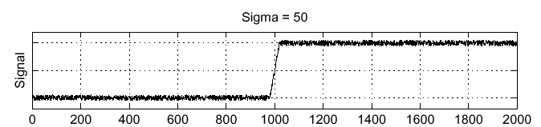
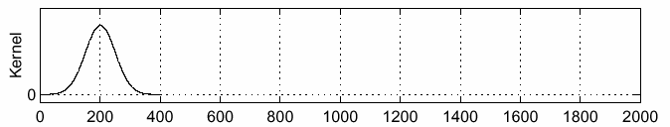
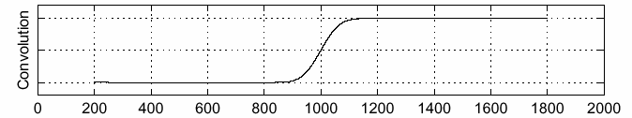
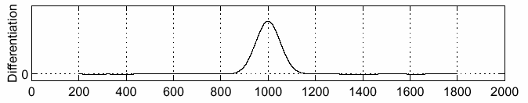
Solution: smooth first
f
g
f * g
To find edges, look for peaks in
Source: S. Seitz
Notes:
39

Slide 40
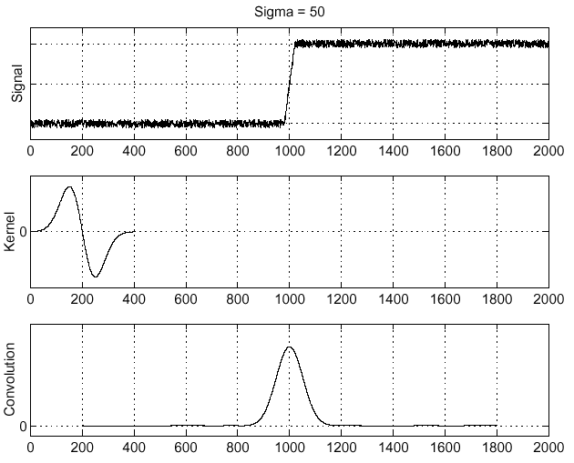
Derivative theorem of convolution
Differentiation is convolution, and convolution is associative:
This saves us one operation:
f
Source: S. Seitz
Notes:
40

Slide 41
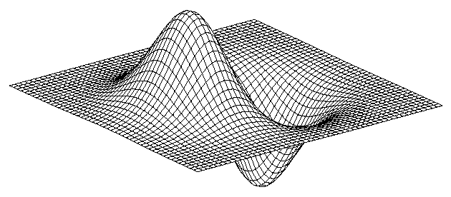
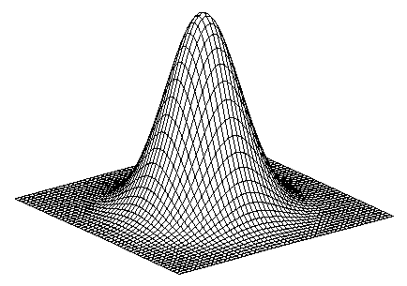
Derivative of Gaussian filter
* [1 0 -1] =
2D-gaussian
x - derivative

Slide 42
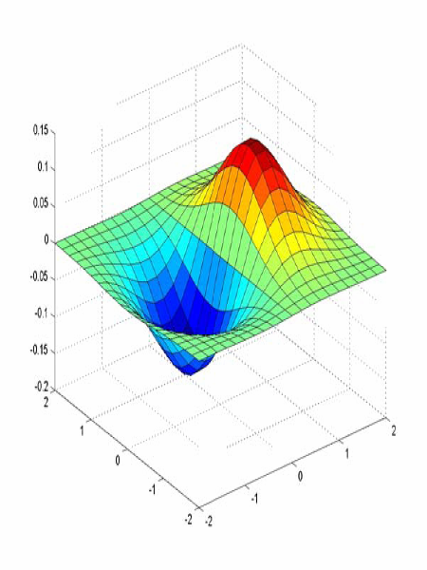
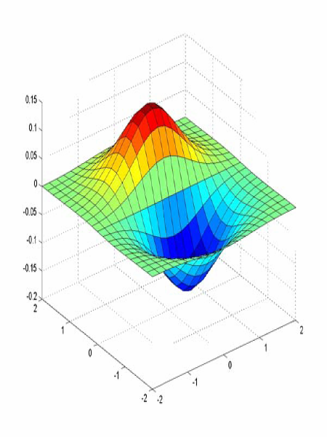
Derivative of Gaussian filter
x-direction
y-direction
Which one finds horizontal/vertical edges?
Source: L. Lazebnik
Notes:
42

Slide 43
Review: Smoothing vs. derivative filters
Smoothing filters
Gaussian: remove “high-frequency” components; “low-pass” filter
Can the values of a smoothing filter be negative?
What should the values sum to?
One: constant regions are not affected by the filter
Derivative filters
Derivatives of Gaussian
Can the values of a derivative filter be negative?
What should the values sum to?
Zero: no response in constant regions
High absolute value at points of high contrast

Slide 44
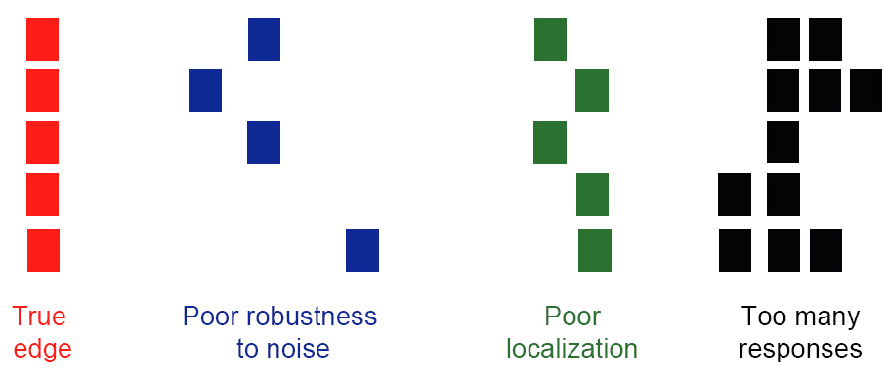
Designing an edge detector
Criteria for an “optimal” edge detector:
Good detection: the optimal detector must minimize the probability of false positives (detecting spurious edges caused by noise), as well as that of false negatives (missing real edges)

Slide 45
Designing an edge detector
Criteria for an “optimal” edge detector:
Good detection: the optimal detector must minimize the probability of false positives (detecting spurious edges caused by noise), as well as that of false negatives (missing real edges)
Good localization: the edges detected must be as close as possible to the true edges

Slide 46
Designing an edge detector
Criteria for an “optimal” edge detector:
Good detection: the optimal detector must minimize the probability of false positives (detecting spurious edges caused by noise), as well as that of false negatives (missing real edges)
Good localization: the edges detected must be as close as possible to the true edges
Single response: the detector must return one point only for each true edge point; that is, minimize the number of local maxima around the true edge

Slide 47
What we will learn today
Edge detection
Image Gradients
A simple edge detector
Sobel Edge detector
Canny edge detector
Template Matching

Slide 48
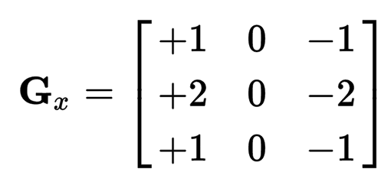
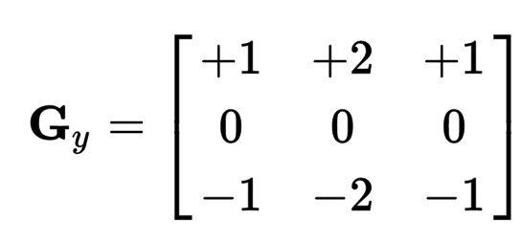
Sobel Operator
uses two 3×3 kernels which are convolved with the original image to calculate approximations of the derivatives
one for horizontal changes, and one for vertical

Slide 49
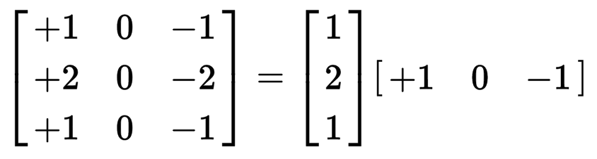
Sobel Operation
Smoothing + differentiation
Gaussian smoothing
differentiation

Slide 50
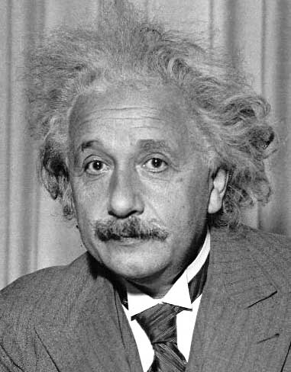
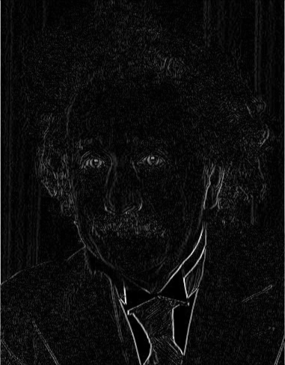
Sobel filter
1
0
-1
2
0
-2
1
0
-1
Sobel
Vertical Edge
(absolute value)

Slide 51
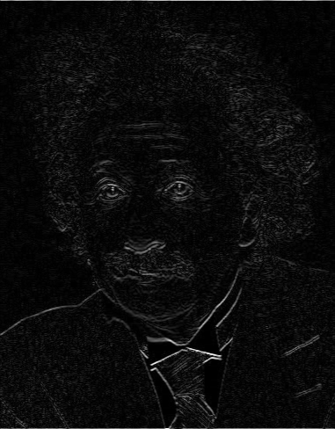
Sobel filter
1
2
1
0
0
0
-1
-2
-1
Sobel
Horizontal Edge
(absolute value)
Notes:
51

Slide 52
Sobel Filter example
Notes:
We can threshold the gradient map, and choose edges to be the pixels above T.

Slide 53
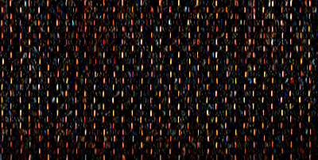
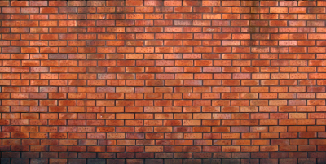

Sobel filter example
Vertical edge
original
Horizontal Edge

Slide 54

Sobel Filter Problems
Poor Localization (Trigger response in multiple adjacent pixels)
Thresholding value favors certain directions over others
Can miss oblique edges more than horizontal or vertical edges
False negatives
Notes:
Thresholding is….

Slide 55
What we will learn today
Edge detection
Image Gradients
A simple edge detector
Sobel Edge detector
Canny edge detector
Template Matching

Slide 56
Canny edge detector
This is probably the most widely used edge detector in computer vision
Theoretical model: step-edges corrupted by additive Gaussian noise
Canny has shown that the first derivative of the Gaussian closely approximates the operator that optimizes the product of signal-to-noise ratio and localization
J. Canny, A Computational Approach To Edge Detection, IEEE Trans. Pattern Analysis and Machine Intelligence, 8:679-714, 1986.

Slide 57
Canny edge detector
Suppress Noise
Compute gradient magnitude and direction
Apply Non-Maximum Suppression
Assures minimal response
Use hysteresis and connectivity analysis to detect edges

Slide 58

Example
original image

Slide 59


Derivative of Gaussian filter
x-direction
y-direction

Slide 60



Compute gradients
X-Derivative of Gaussian
Y-Derivative of Gaussian
Gradient Magnitude
Source: J. Hayes

Slide 61

Get orientation at each pixel
Source: J. Hayes
Notes:
Gives angle perpendicular to the edge.

Slide 62



Compute gradients
X-Derivative of Gaussian
Y-Derivative of Gaussian
Gradient Magnitude

Slide 63
Canny edge detector
Suppress Noise
Compute gradient magnitude and direction
Apply Non-Maximum Suppression
Assures minimal response

Slide 64

Non-maximum suppression
Check if pixel is local maximum along gradient direction, select single max across width of the edge
requires checking interpolated pixels p and r

Slide 65

Non-max Suppression
Before After

Slide 66
Canny edge detector
Suppress Noise
Compute gradient magnitude and direction
Apply Non-Maximum Suppression
Assures minimal response
Use hysteresis and connectivity analysis to detect edges

Slide 67



Slide 68
Hysteresis thresholding
Avoid streaking near threshold value
Define two thresholds: Low and High
If less than Low, not an edge
If greater than High, strong edge
If between Low and High, weak edge

Slide 69
Hysteresis thresholding
If the gradient at a pixel is
above High, declare it as an ‘strong edge pixel’
below Low, declare it as a “non-edge-pixel”
between Low and High
Consider its neighbors iteratively then declare it an “edge pixel” if it is connected to an ‘strong edge pixel’ directly or via pixels between Low and High

Slide 70
Hysteresis thresholding
strong edge pixel
weak but connected edge pixels
strong edge pixel
Source: S. Seitz
Notes:
Breadth first search in the homework.

Slide 71

Final Canny Edges

Slide 72





Effect of σ (Gaussian kernel spread/size)
original
Canny with
Canny with
The choice of σ depends on desired behavior
large σ detects large scale edges
small σ detects fine features
Source: S. Seitz
Notes:
72

Slide 73
Recap: Canny edge detector
Filter image with x, y derivatives of Gaussian
Find magnitude and orientation of gradient
Non-maximum suppression:
Thin wide “ridges” down to single pixel width
Linking and thresholding (hysteresis):
Define two thresholds: low and high
Use the high threshold to start edge curves and the low threshold to continue them
J. Canny, A Computational Approach To Edge Detection, IEEE Trans. Pattern Analysis and Machine Intelligence, 8:679-714, 1986.

Slide 74






Image gradients vs. meaningful contours
image
human segmentation
gradient magnitude
Berkeley segmentation database: http://www.eecs.berkeley.edu/Research/Projects/CS/vision/grouping/segbench/

Slide 75


Data-driven edge detection
Input images
Training data
Ground truth
Output
P. Dollar and L. Zitnick, Structured forests for fast edge detection, ICCV 2013

Slide 76


Template matching
Template (mask)
Scene
A toy example
Notes:
76

Slide 77

Template matching
Template
Detected template
Notes:
77

Slide 78

Template matching
Detected template
Correlation map
Notes:
78

Slide 79

Where’s Waldo?
Template
Scene
Notes:
79

Slide 80

Where’s Waldo?
Template
Scene
Notes:
80

Slide 81

Where’s Waldo?
Detected template
Correlation map
Notes:
81

Slide 82


Template matching
Template
Scene
What if the template is not identical to some subimage in the scene?
Notes:
82

Slide 83

Template matching
Template
Detected template
Match can be meaningful, if scale, orientation, and general appearance is right.
Notes:
83

Slide 84
Template matching
Goal: find in image
Main challenge: What is a good similarity or distance measure between two patches?
Correlation
Zero-mean correlation
Sum Square Difference
Normalized Cross Correlation
Notes:
84

Slide 85

Matching with filters
Goal: find in image
Method 0: filter the image with eye patch
f = image
g = filter
What went wrong?
Input
Filtered Image
Notes:
Problem: response is stronger for higher intensity
85

Slide 86


Matching with filters
Goal: find in image
Method 1: filter the image with zero-mean eye
mean of g
True detections
False detections
Input
Filtered Image (scaled)
Thresholded Image
Notes:
Likes bright pixels where filters are above average, dark pixels where filters are below average. Problems: response is sensitive to gain/contrast, pixels in filter that are near the mean have little effect, does not require pixel values in image to be near or proportional to values in filter.
86

Slide 87


Matching with filters
Goal: find in image
Method 2: SSD
True detections
Input
1- sqrt(SSD)
Thresholded Image
Notes:
Problem: SSD sensitive to average intensity
87

Slide 88


Matching with filters
What’s the potential downside of SSD?
Goal: find in image
Method 2: SSD
Input
1- sqrt(SSD)
Notes:
Problem: SSD sensitive to average intensity
88

Slide 89
Matching with filters
Goal: find in image
Method 3: Normalized cross-correlation
mean template
mean image patch
Matlab: normxcorr2(template, im)
Notes:
Invariant to mean and scale of intensity
89

Slide 90


Matching with filters
Goal: find in image
Method 3: Normalized cross-correlation
True detections
Input
Normalized X-Correlation
Thresholded Image
Notes:
90

Slide 91

Matching with filters
Goal: find in image
Method 3: Normalized cross-correlation
True detections
Input
Normalized X-Correlation
Thresholded Image
Notes:
91

Slide 92
Q: What is the best method to use?
A: Depends
Zero-mean filter: fastest but not a great matcher
SSD: next fastest, sensitive to overall intensity
Normalized cross-correlation: slowest, invariant to local average intensity and contrast

Slide 93
Q: What if we want to find larger or smaller eyes?
A: Image Pyramid

Slide 94



Image Sub-Sampling
1/8
1/4
Throw away every other row and column to create a 1/2 size image
- called image sub-sampling

Slide 95
Image Sub-Sampling
1/2
1/4 (2x zoom)
1/8 (4x zoom)

Slide 96

Subsampling by a factor of 2
Throw away every other row and column to create a 1/2 size image

Slide 97
Sampling and aliasing problem
Sub-sampling may be dangerous
Characteristic errors may appear, may not reconstruct the original signal

Slide 98


Nyquist-Shannon Sampling Theorem
When sampling a signal at discrete intervals, the sampling frequency must be ≥ 2 × f_{max}
f_{max} = max frequency of the input signal
This will allows to reconstruct the original perfectly from the sampled version
v
v
v
good
bad
Notes:
98

Slide 99
Anti-aliasing
Solutions:
Sample more often
Get rid of all frequencies that are greater than half the new sampling frequency
Will lose information
But it’s better than aliasing
Apply a smoothing filter

Slide 100
Algorithm for downsampling by factor of 2
Start with image(h, w)
Apply low-pass filter
im_blur = imfilter(image, fspecial(‘gaussian’, 7, 1))
Sample every other pixel
im_small = im_blur(1:2:end, 1:2:end);

Slide 101
Anti-aliasing
Forsyth and Ponce 2002

Slide 102
Review of Sampling
Gaussian
Filter
Image
Low-Pass Filtered Image
Sample
Low-Res Image

Slide 103
Subsampling without pre-filtering
1/2
1/4 (2x zoom)
1/8 (4x zoom)
Slide by Steve Seitz

Slide 104



Subsampling with Gaussian pre-filtering
Gaussian 1/2
G 1/4
G 1/8
Slide by Steve Seitz

Slide 105

Gaussian pyramid
Source: Forsyth

Slide 106
Template Matching with Image Pyramids
Input: Image, Template
Match template at current scale
Downsample image
Repeat 1-2 until image is very small
Take responses above some threshold, perhaps with non-maxima suppression (supressing all image information that is not part of local maxima)

Slide 107


Laplacian filter
unit impulse
Gaussian
Laplacian of Gaussian
Source: Lazebnik

Slide 108

Laplacian pyramid
Source: Forsyth

Slide 109










The Laplacian Pyramid
Gaussian Pyramid
Laplacian Pyramid
expand
-
=
expand
-
=
expand
-
=

Slide 110
Applications of Image Pyramids
Coarse-to-Fine strategies for computational efficiency.
Search for correspondence
look at coarse scales, then refine with finer scales
Edge tracking
a “good” edge at a fine scale has parents at a coarser scale
Control of detail and computational cost in matching
e.g. finding stripes
very important in texture representation
Image Blending and Mosaicing
Data compression (laplacian pyramid)

Slide 111



Slide 112






Now: Fitting
Want to associate a model with observed features
[Fig from Marszalek & Schmid, 2007]
For example, the model could be a line, a circle, or an arbitrary shape.
Kristen Grauman
Notes:
112
CS 376 Lecture 8 Fitting

Slide 113



Example: Line fitting
Why fit lines?
Many objects characterized by presence of straight lines
Wait, why aren’t we done just by running edge detection?
Kristen Grauman
Notes:
113
CS 376 Lecture 8 Fitting

Slide 114

Difficulty of line fitting
Extra edge points (clutter), multiple models:
which points go with which line, if any?
Only some parts of each line detected, and some parts are missing:
how to find a line that bridges missing evidence?
Noise in measured edge points, orientations:
how to detect true underlying parameters?
Kristen Grauman
Notes:
114
CS 376 Lecture 8 Fitting

Slide 115
Fitting lines: Hough transform
Given points that belong to a line, what is the line?
How many lines are there?
Which points belong to which lines?
Hough Transform is a voting technique that can be used to answer all of these questions.
Main idea:
1. Record vote for each possible line on which each edge point lies.
2. Look for lines that get many votes.
Kristen Grauman
Notes:
115
CS 376 Lecture 8 Fitting

Slide 116
Hough transform
An early type of voting scheme
Discretize parameter space into bins
For each feature point in the image, put a vote in every bin in the parameter space that could have generated this point
Find bins that have the most votes
Image space
Hough parameter space
P.V.C. Hough, Machine Analysis of Bubble Chamber Pictures, Proc. Int. Conf. High Energy Accelerators and Instrumentation, 1959
Notes:
Hough voting is a voting procedure as well, where each data points counts for a “vote” for one or more models that we want to fit to our data.

Slide 117


Finding lines in an image: Hough space
y
b
b₀
x
m₀
m
image space
Hough (parameter) space
Connection between image (x,y) and Hough (m,b) spaces
A line in the image corresponds to a point in Hough space
To go from image space to Hough space:
given a set of points (x,y), find all (m,b) such that y = mx + b
Slide credit: Steve Seitz
Notes:
117
CS 376 Lecture 8 Fitting

Slide 118


Finding lines in an image: Hough space
y
b
y₀
x₀
x
m
image space
Hough (parameter) space
Connection between image (x,y) and Hough (m,b) spaces
A line in the image corresponds to a point in Hough space
To go from image space to Hough space:
given a set of points (x,y), find all (m,b) such that y = mx + b
What does a point (x₀, y₀) in the image space map to?
Answer: the solutions of b = -x₀m + y₀
this is a line in Hough space
Slide credit: Steve Seitz
Notes:
118
CS 376 Lecture 8 Fitting

Slide 119
Finding lines in an image: Hough space
y
b
(x₁, y₁)
y₀
(x₀, y₀)
b = –x₁m + y₁
x₀
x
m
image space
Hough (parameter) space
What are the line parameters for the line that contains both (x₀, y₀) and (x₁, y₁)?
It is the intersection of the lines b = –x₀m + y₀ and b = –x₁m + y₁
Notes:
119
CS 376 Lecture 8 Fitting

Slide 120
Finding lines in an image: Hough algorithm
y
b
x
m
image space
Hough (parameter) space
How can we use this to find the most likely parameters (m,b) for the most prominent line in the image space?
Let each edge point in image space vote for a set of possible parameters in Hough space
Accumulate votes in discrete set of bins; parameters with the most votes indicate line in image space.
Notes:
120
CS 376 Lecture 8 Fitting

Slide 121

Parameter space representation
Problems with the (m,b) space:
Unbounded parameter domains
Vertical lines require infinite m
Alternative: polar representation
Each point (x,y) will add a sinusoid in the (θ,ρ) parameter space

Slide 122


Slide 123

Algorithm outline
Initialize accumulator H to all zeros
For each feature point (x,y) in the image For θ = 0 to 180 ρ = x cos θ + y sin θ H(θ, ρ) = H(θ, ρ) + 1 end end
Find the value(s) of (θ, ρ) where H(θ, ρ) is a local maximum
The detected line in the image is given by ρ = x cos θ + y sin θ
ρ
θ

Slide 124

Effect of noise
features
votes
Notes:
This is 15.1 lower half

Slide 125
Effect of noise
features
votes
Peak gets fuzzy and hard to locate
Notes:
This is 15.1 lower half

Slide 126


Slide 127

Random points
features
votes
Uniform noise can lead to spurious peaks in the array
Notes:
15.2; main point is that lots of noise can lead to large peaks in the array

Slide 128
Dealing with noise
Choose a good grid / discretization
Too coarse: large votes obtained when too many different lines correspond to a single bucket
Too fine: miss lines because some points that are not exactly collinear cast votes for different buckets
Increment neighboring bins (smoothing in accumulator array)
Try to get rid of irrelevant features
E.g., take only edge points with significant gradient magnitude

Slide 129


Several lines

Slide 130

A more complicated image
http://ostatic.com/files/images/ss_hough.jpg

Slide 131
Example video
https://youtu.be/4zHbI-fFIlI?t=3m35s

Slide 132

Hough transform for circles
Circle: center (a,b) and radius r
For a fixed radius r, unknown gradient direction
Image space
Hough space
Kristen Grauman
Notes:
132
CS 376 Lecture 8 Fitting

Slide 133
Hough transform for circles
Circle: center (a,b) and radius r
For a fixed radius r, unknown gradient direction
Intersection: most votes for center occur here.
Image space
Hough space
Kristen Grauman
Notes:
133
CS 376 Lecture 8 Fitting

Slide 134
Hough transform for circles
Circle: center (a,b) and radius r
For an unknown radius r, unknown gradient direction
r
?
b
a
Image space
Hough space
Kristen Grauman
Notes:
134
CS 376 Lecture 8 Fitting

Slide 135

Hough transform for circles
Circle: center (a,b) and radius r
For an unknown radius r, unknown gradient direction
r
b
a
Image space
Hough space
Kristen Grauman
Notes:
135
CS 376 Lecture 8 Fitting

Slide 136
Hough transform for circles
For every edge pixel (x,y) :
For each possible radius value r:
For each possible gradient direction θ:
// or use estimated gradient at (x,y)
a = x – r cos(θ) // column
b = y + r sin(θ) // row
H[a,b,r] += 1
Kristen Grauman
Notes:
136
CS 376 Lecture 8 Fitting

Slide 137



Example: detecting circles with Hough
Original
Edges
Votes: Penny
Note: a different Hough transform (with separate accumulators) was used for each circle radius (quarters vs. penny).
Notes:
137
CS 376 Lecture 8 Fitting

Slide 138
Example: detecting circles with Hough
Combined detections
Original
Edges
Votes: Quarter
Coin finding sample images from: Vivek Kwatra
Notes:
138
CS 376 Lecture 8 Fitting

